Slide 1
Linux System Tuning for Access Points Greg Thain

Slide 2
Agenda
Goals of Tuning / This talk:
Prevent Crashes
Raise Throughput
Topics:
Provisioning Memory
Disk space and disk latency
Sandbox transfers
Cpus

Slide 3
Don't Panic!
Out of the box defaults work for many sites
Fewer than 10,000 jobs, probably ok
But many of you are running bigger sites…
Or are using VMs/container with knobs

Slide 4
The memory hotplug surprise
Kernel autosizes most knobs appropriately
fds, disk caches, process limits, etc.
…Except when vm memory hotplug enabled.

Slide 5
Use worker node for AP?
Works fine for small sites,
But if you have the budget, here's what to do…

Slide 6
Biggest problem with Access Points?

Slide 7
Users!

Slide 8
$ ssh head-node
Password:
Success. Logging you in...
Welcome to Ubuntu 18.04.6 LTS
Running jobs directly on the head node will not be tolerated and will lead to the immediate suspension of your account to protect the scheduler.

Slide 9
Users (generally) want to do right thing
"AP is a shared resource, treat it like one"
"Use some of the AP, but not too much" - ???

Slide 10
$ uptime
12:16:52 up 53 days,35 users,load average: 12.49, 10.98, 12.07
$ ps auxwwr
gthain 1033 0.0 1364252 488980 R 126:11 /home/gthain/.vscode…-
gthain 1033 0.0 2364252 184980 R 225:01 /home/gthain/.vscode…-
gthain 1033 0.0 2360152 388980 R 26:11 /home/gthain/.vscode…-
gthain 1033 0.0 3364252 288980 R 326:11 /home/gthain/.vscode…-
gthain 1033 0.0 1004252 188980 R 426:11 /home/gthain/.vscode…-
…

Slide 11
Solution: ulimit the cpu
/etc/security/limits.d/30-cpus
Units are in MINUTES!
# Prevent rogue user processes from consuming
# Too many resources for too long.
* soft cpu 118
* hard cpu 120
root soft cpu unlimited
root hard cpu unlimited

Slide 12
Memory
1st rule of provisioning AP Memory:

Slide 13
Memory
1st rule of provisioning AP Memory:
DO NOT ENABLE SWAPPING / PAGING

Slide 14
Memory
Schedd holds all* job ads IN MEMORY
*including held jobs!
Roughly 1Gb / 10,000 ads
One condor_shadow process per running job
Roughly 1 Mb / condor_shadow
we work hard to limit this (spoiler: hard)

Slide 15
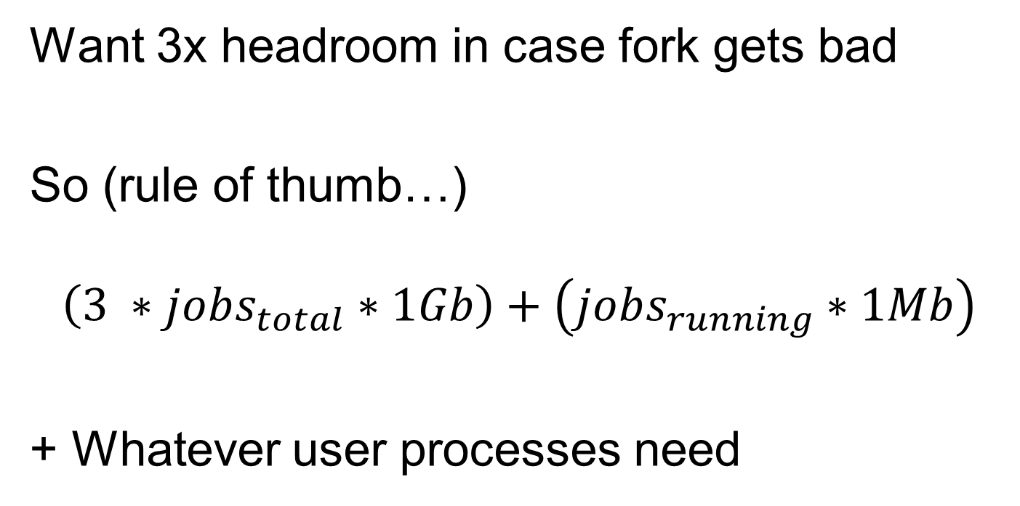
Schedd Forks for queries!
Want 3x headroom in case fork gets bad
So (rule of thumb…)
$$\left(3 ∗jobs_{total}∗1Gb\right)+\left(jobs_{running}∗1Mb\right)$$
+ Whatever user processes need

Slide 16
CPUs
condor_schedd is (mostly) single-threaded
what does this mean?
Adding more cpus doesn't help schedd
One slow call holds up the whole thing
Leads to DaemonCoreDutyCycle

Slide 17
DaemonCoreDutyCycle
condor_status –af RecentDaemonCoreDutyCyle
< 0.95 → Probably OK
≥ 0.95 → Probably too busy

Slide 18
DC status from 2023-09-19 14:59:05 to 2023-09-19 15:03:05:
Duty Cycle: 88.09% Ops/second: 40.375
Runtime stats from 2023-09-19 14:59:05 to 2023-09-19 15:03:05:
InstRt InstAvg TotAvg TotMax RtPctAvg InstRate AvgRate Item
93.115 0.07747 0.13 27.98 59.7981 5.01 0.49 Timer_start_job
78.429 0.09472 0.10 27.94 99.2199 3.45 0.62 Create_ProcessTot
39.962 0.00978 0.03 107.81 36.4341 17.02 5.01 fsync
22.536 0.33142 0.22 63.14 150.6389 0.28 0.28 SCWalkJobQ
17.386 0.39513 0.26 5.37 152.7251 0.18 0.17 SCBuildPrioRec
16.506 0.37515 0.25 5.36 152.2462 0.18 0.17 SCWalkJobQ_get_job_prio
7.628 0.16582 0.08 436.30 211.2148 0.19 0.41 Timer_timeout
6.410 0.11245 0.18 21.41 62.6880 0.24 0.17 Timer_StartJobHandler
5.979 0.00000 0.00 0.15 101.7150 12196.33 9285.09 SCGetAutoCluster
4.558 0.00000 0.00 0.07 111.3440 12177.73 9265.80 SCGetAutoCluster_hit
4.352 0.43525 0.31 2.35 140.5082 0.04 0.05 SCWalkJobQ_count_a_job
3.994 0.01035 0.01 19.10 119.8948 1.61 0.62 Signal_HandleDC_SERVICEWAITPIDS
2.095 0.00858 0.01 0.28 160.8964 1.02 0.22 Timer_checkContactQueue
1.420 0.00032 0.00 0.15 108.3520 18.60 19.29 SCGetAutoCluster_signature
1.100 0.09167 0.02 1.17 473.9021 0.05 0.08 Timer_TokenRequesttryTokenRequests
1.001 0.10009 0.06 0.68 171.1175 0.04 0.05 SCWalkJobQ_check_for_spool_zombies
0.993 0.00229 0.00 0.65 102.5686 1.80 0.66 Signal_HandleDC_SIGCHLD
0.699 0.00065 0.00 0.25 312.8221 4.48 1.91 Timer_CheckTransferQueue
0.677 0.16925 0.14 63.14 116.8083 0.02 0.02 Timer_PeriodicExpr
0.676 0.16912 0.14 63.14 116.8294 0.02 0.02 SCWalkJobQ_PeriodicExprEval
0.621 0.00053 0.00 3.46 89.0456 4.84 1.28 Command_TRANSFER_QUEUE_REQUEST
0.619 0.00010 0.00 25.55 108.1283 26.82 14.36 Command_QMGMT_WRITE_CMD
0.577 0.01310 0.01 2.43 188.7987 0.18 0.17 SCBuildPrioRec_sort
0.558 0.00237 0.00 4.94 84.6769 0.98 0.53 Timer_SelfDrainingQueuetimerHandlerjob_is_finished_queue

Slide 19
Two blocking calls to know
Slow DNS queries
Slow fsync

Slide 20
Slow DNS queries in SchedLog
09/12/23 10:14:02 (D_ALWAYS) WARNING: Saw slow DNS query, which may impact entire system: getaddrinfo(cm.chtc.wisc.edu) took 24.445889 seconds.

Slide 21
Slow fsync
09/19/23 00:37:06 (pid:2903754) (D_ALWAYS:2) Transaction::Commit(): fdatasync() took 11 seconds to run

Slide 22
Schedd not only user of CPU
Xfer'ing shadow uses 5-10% of a cpu*
Very little otherwise
User work also uses cpus
So provision cpus on APs accordingly

Slide 23
Disk: Two aspects
Space
Latency (not throughput)

Slide 24
SPOOL
All spooled files (including checkpoints) go in
condor_config_val SPOOL
Bad things will happen if this fills up.
Ideally on separate partition
Can configure a per-user SPOOL with
…

Slide 25
job_queue.log
(sorry about the name log) The schedd's transaction log
FSYNC'd very frequently
can slow down whole schedd

Slide 26
Fsync and ext3
Fsync (actually fdatasync) call on ext3
can be very slow
Please use JOB_QUEUE_LOG to put
job_queue.log on own partition
AND if one nvme/ssd drive, put it there. May be biggest thing you can do for the AP

Slide 27
Networking
Assuming condor file transfer..
More is better – 10Gb, 100+Gb
Install fq_codel if not already on
Think about ratio of AP to EP and
# of concurrent transfers

Slide 28
File Transfer Model
WAN
shadow
eth0
shadow
shadow
shadow
shadow
shadow
shadow
shadow
cache
shadow
shadow
shadow
disk
shadow
EP
EP
EP
EP
Transfer queue

Slide 29
File Transfer Model
EP

Slide 30
File Transfer (EP side)
EP
eth0
starter
shadow
starter
cache
shadow
starter
shadow
starter
shadow
disk

Slide 31
File Transfer – WHY?
WAN
shadow
eth0
shadow
shadow
shadow
shadow
shadow
shadow
shadow
cache
shadow
shadow
shadow
disk
shadow
EP
EP
EP
EP
Transfer queue
EP
EP
EP
EP

Slide 32
File Transfer Speeds
WAN
shadow
eth0
shadow
shadow
shadow
shadow
shadow
shadow
shadow
cache
shadow
shadow
shadow
disk
shadow
EP
EP
EP
EP
Transfer queue

Slide 33
HTCondor's throttles
WAN
FILE_TRANSFER_MAX_UPLOAD
# Default = 100
shadow
eth0
shadow
shadow
shadow
shadow
shadow
shadow
shadow
cache
shadow
shadow
FILE_TRANSFER_LOAD_THROTTLE
# Default = 2
shadow
disk
shadow
EP
EP
EP
EP
Transfer queue

Slide 34
HTCondor's throttles
WAN
FILE_TRANSFER_MAX_UPLOAD
# Default = 100
shadow
eth0
shadow
shadow
shadow
Problem with ZFS:
On ZFS, 1 xfer → 1 load
Solution: raise to 1,000 (!)
shadow
shadow
shadow
shadow
cache
shadow
shadow
FILE_TRANSFER_LOAD_
# Default = 2
shadow
disk
shadow
EP
EP
EP
EP
Transfer queue

Slide 35
HTCondor's throttles
WAN
FILE_TRANSFER_MAX_UPLOAD
# Default = 100
shadow
eth0
shadow
shadow
shadow
shadow
shadow
shadow
shadow
cache
shadow
shadow
FILE_TRANSFER_LOAD_THROTTLE
# Default = 2
shadow
disk
shadow
EP
EP
EP
EP
Transfer queue

Slide 36

HTCondor's throttles
WAN
FILE_TRANSFER_MAX_UPLOAD
# Default = 100
eth0
shadow
More Common problem
What should this be?
$$\frac{AP NIC}{mean(EP NIC)}$$
shadow
shadow
shadow
shadow
shadow
shadow
shadow
cache
shadow
shadow
FILE_TRANSFER_DISK_LOAD_THROTTLE
# Default = 2
shadow
disk
shadow
EP
EP
EP
EP
Transfer queue

Slide 37
Things to look at

Slide 38
$ condor_status –schedd –l name_of_your_schedd | grep Transfer
FileTransferMBWaitingToUpload = 0.0
FileTransferUploadBytes = 181516308696053.0
FileTransferUploadBytesPerSecond_1d = 64747373.05902614
FileTransferUploadBytesPerSecond_1h = 215636610.644708
FileTransferUploadBytesPerSecond_1m = 56930145.62086731
FileTransferUploadBytesPerSecond_5m = 120896405.913133
TransferQueueMaxUploading = 100
TransferQueueNumUploading = 10
TransferQueueNumUploadingPeak = 100
TransferQueueNumWaitingToUpload = 0
TransferQueueNumWaitingToUploadPeak = 5582
TransferQueueUploadWaitTime = 0
TransferQueueUploadWaitTimePeak = 11482

Slide 39
Thank you!
Remember:
Don't panic about modest APs
Put job_queue.log on own disk (nvme?)
Keep monitoring your AP
Especially DaemonCoreDutyCycle
Questions?

